Slide 1


Robert Wagner
7-23-2022

Slide 2

Outline
Executive Summary
Introduction
Methodology
Results
Conclusion
Appendix

Slide 3
Executive Summary - Methodology
Business Understanding
Data Collection
Exploratory Data Analysis
Predictive Analysis
If we can predict whether the Falcon 9 first stage will land, we can determine the cost of a launch.
Collected data using:
SpaceX API
Web Scraping from Wikipedia using BeautifulSoup
Visualized and explored data using:
SQL
MatPlotLib
Seaborn
Folium
Plotly Dashboard
Ran and analyzed Predictive Analysis using models such as:
Decision Trees
Support Vector Machines
K-Nearest Neighbors
Logistic Regression
GridSearch

Slide 4
Executive Summary – Results
All models achieved an 83% test accuracy, but the Decision Tree model achieved an 87.5% validation accuracy.

Slide 5
Introduction
We are SpaceY.
In the commercial rocket industry, SpaceX has dominated the industry with their reusable first stage rocket technology. A SpaceX Falcon 9 Rocket costs $62M compared to $165M at other companies due to this technology. If SpaceY can predict if the first stage will land, we can determine the cost of a launch.
Desirable Answers:
We can predict with some accuracy the success rate for first stage rocket landings.

Slide 6

Section 1

Slide 7
Methodology
Executive Summary
Data collection methodology:
SpaceX REST API
Web scraping with BeautifulSoup.
Perform data wrangling
After collecting the data, it was cleaned and summarized by dropping unhelpful information, and replacing null values.
Perform exploratory data analysis (EDA) using visualization and SQL
Visualizations and SQL were used to select for features with correlations to the success of landing outcomes.

Slide 8
Methodology
Executive Summary
Perform interactive visual analytics using Folium and Plotly Dash
Folium was used to Visualize how Launch Site affected landing outcome.
Plotly was used to create a dashboard displaying landing outcome based on Launch Site and Payload.
Perform predictive analysis using classification models
Grid Search was used to tune hyperparameters for predictive models such as:
Decision Tree
Support Vector Machine
Logistic Regression
K-Nearest Neighbors

Slide 9
Data Collection
SpaceX API
Enter SpaceX API URL.
Request JSON using URL, save as Response Object.
Convert JSON Response Object into DataFrame.
Filter useful data from DataFrame.
Remove or Replace missing values.
Web Scraping
Request HTML page from Wikipedia
Convert HTML into text.
Parse text using BeautifulSoup.
Extract columns into Python Dictionary.
Convert Dictionary to DataFrame.

Slide 10
Data Collection – SpaceX API
Using the SpaceX Rest API, the shown process was followed to collect and clean the data.
Request using API
Convert JSON to DataFrame
Filter Data
Remove/Replace Missing Values
https://api.spacexdata.com/v4/launches/past
https://github.com/robwagner0317/IBMDataScience/blob/87479a6d1036459b34d9584a796fee3701de64ce/Data%20Collection.ipynb

Slide 11
Data Collection - Scraping
Using request, get HTML page from Wikipedia
Convert HTML into Text
Parse text data using Beautiful Soup
Extract Columns into Python Dictionary
Convert to Dataframe
Data was requested and parsed using the shown process.
https://en.wikipedia.org/wiki/List_of_Falcon\_9\_and_Falcon_Heavy_launches
https://github.com/robwagner0317/IBMDataScience/blob/87479a6d1036459b34d9584a796fee3701de64ce/Data%20Collection%20with%20Web%20Scraping.ipynb

Slide 12
Data Wrangling
EDA
Analyze Missing Values
Analyze Features
Select Training Labels
Explore data. Determine data shape and what features are available.
Determine what features are missing data and if that feature is important. Decide whether to drop or replace.
Explore which features might correlate with Landing Outcome
Features Explored:
Launch Site
Orbit
Select feature for Training labels. Using the Outcome feature. We divided good and bad outcomes and created a new Landing Outcome feature to train our models.
IBMDataScience/Data Wrangling.ipynb at master · robwagner0317/IBMDataScience (github.com)

Slide 13
EDA with Data Visualization
To determine any correlations in certain features, using MatPlotLib and Seaborn the following charts were visualized:
Flight Number vs Launch Site (Scatter)
Payload vs Launch site (Scatter)
Success Rate by Orbit Type (Bar)
Flight Number vs Orbit Type (Scatter)
Payload vs Orbit Type (Scatter)
Lauch Success Yearly Trend (Line)
IBMDataScience/EDA_Data_Vis.ipynb at master · robwagner0317/IBMDataScience (github.com)

Slide 14
EDA with SQL
To explore the data the following SQL Queries were performed:
Names of unique Launch Sites.
First 5 records of Launch Sites beginning with ‘CCA’.
Total Payload Mass carried by NASA (CRS) boosters..
Average Payload Mass carried by booster F9 v1.1.
First successful ground pad landing date.
Names of boosters with drone ship success and payload mass between 4000kg and 6000kg.
Total number of successful and failure mission outcomes.
Names of Booster Versions which have carried maximum Payload Mass.
Failure Landing Outcomes with Booster Version, Launch Site, and Month in 2015.
Rank of landing outcomes between 04-06-2010 and 20-03-2017 in descending order.
IBMDataScience/EDA_with_SQL.ipynb at master · robwagner0317/IBMDataScience (github.com)

Slide 15
Build an Interactive Map with Folium
First, we mark all the Launch Sites on the map with circles. This gives us reference points for Launch Successes.
We then mark all of the individual launches, coloring them for Success vs Failure.
Finally, calculate the distance between launch sites and its proximities. We can gain insight on optimal launch parameters by visualizing Launch location and nearby features.
IBMDataScience/Folium Visualization.ipynb at master · robwagner0317/IBMDataScience (github.com)

Slide 16
Build a Dashboard with Plotly Dash
By building a Plotly Dashboard, we can visualize launch features interactively to gain insights on the data.
The Dashboard includes the following features:
Launch Site Selector.
Success by Launch Site Pie Chart.
Payload Mass Range Selector.
Payload vs Success Scatter by Payload Mass and Booster Type.
IBMDataScience/spacex_dash_app.py at master · robwagner0317/IBMDataScience (github.com)

Slide 17
Predictive Analysis (Classification)
Using GridSearchCV, four different models were validated using a Test/Train Split and then tested on separate test data.
Decision Tree
SVM
KNN
Logistic Regression
Split data
Grid Search each model to find optimal hyperparameters
Test models on test data
IBMDataScience/Predictive Analysis.ipynb at master · robwagner0317/IBMDataScience (github.com)

Slide 18
Results
Exploratory data analysis results
Interactive analytics demo in screenshots
Predictive analysis results

Slide 19

Section 2

Slide 20
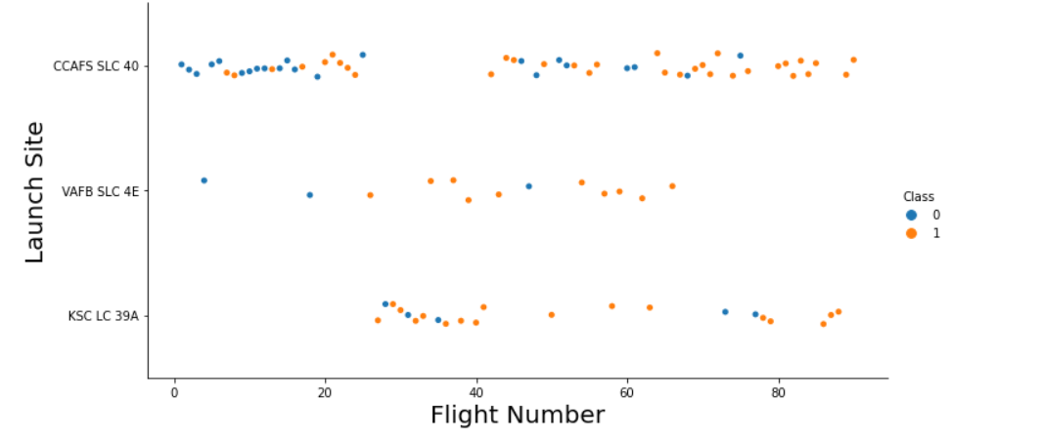
Flight Number vs. Launch Site
Generally, as Flight Number increases, successes also increase.
CCAFS SLC 40 has the most launches overall.
VAFB SLC 4E has the least launches overall.
KSC LC 39A and VAFB SLC 4E have a higher success rate than CCAFS SLC 40

Slide 21
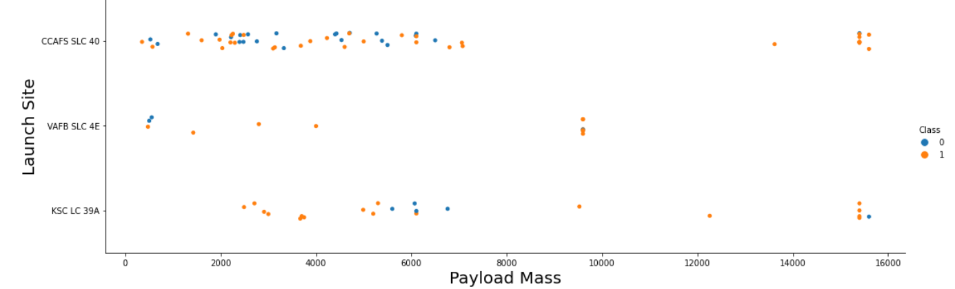
Payload vs. Launch Site
VAFB SLC 4E cannot launch heavier payloads.

Slide 22
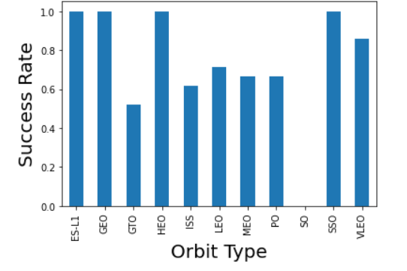
Success Rate vs. Orbit Type
ES-L1, GEO, HEO, and SSO have best success rates.
No launches in SO.
GTO has worst success rate.

Slide 23
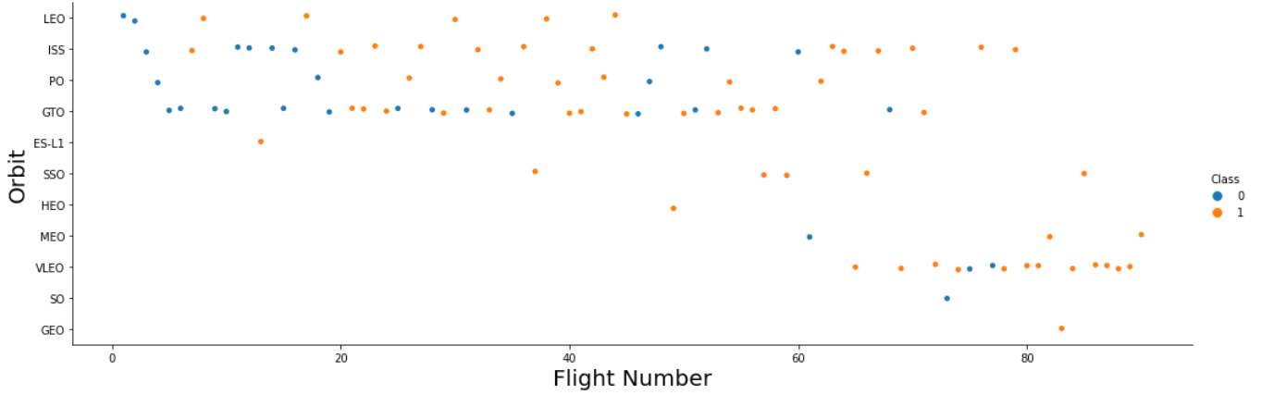
Flight Number vs. Orbit Type
LEO Success Rate increases as Flight Number Increases.
No correlation for any other orbit type.

Slide 24
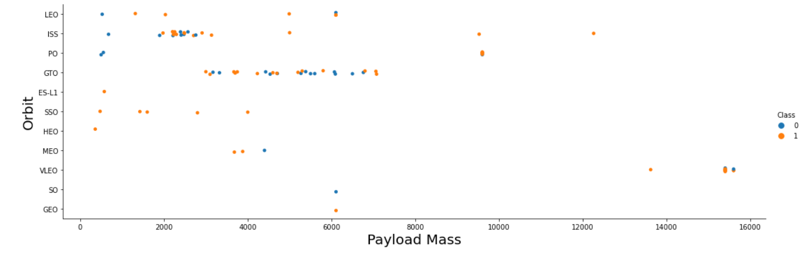
Payload vs. Orbit Type
LEO, PO, and ISS have increased success rates as Payload Mass increases.
No other correlation.

Slide 25
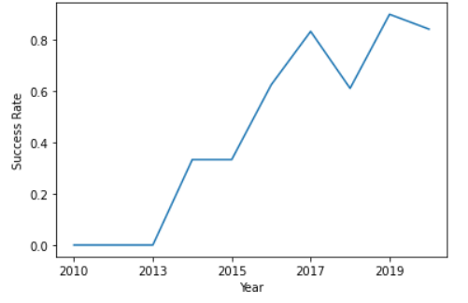
Launch Success Yearly Trend
Success rate increases from 2013 till 2019, with a sharp drop in 2018.

Slide 26
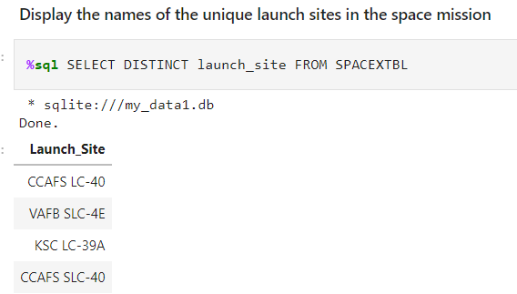
All Launch Site Names
Using basic SQL unique Launch Site names were found.

Slide 27
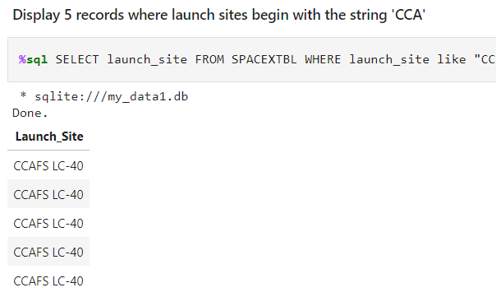
Launch Site Names Begin with 'CCA'
Using basic SQL, the first 5 records with Launch Site names starting with ‘CCA’ were found.

Slide 28
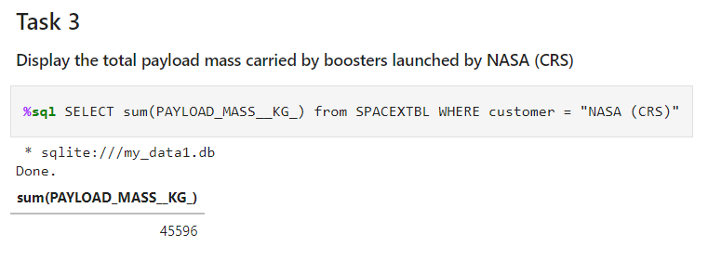
Total Payload Mass
Using basic SQL, total payload mass carried by NASA (CRS) boosters was found.

Slide 29
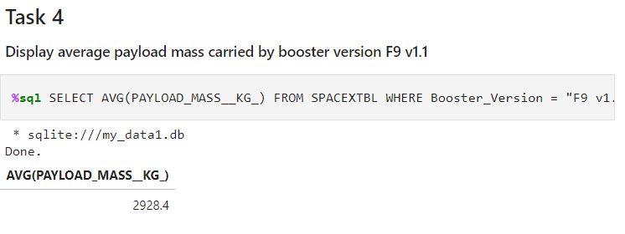
Average Payload Mass by F9 v1.1
Using basic SQL, Average payload mass carried by F9 v1.1 was found.

Slide 30
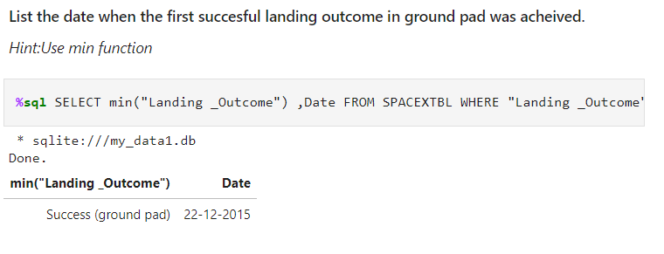
First Successful Ground Landing Date
Using basic SQL, the dates of the first successful landing outcome on ground pad were found.

Slide 31
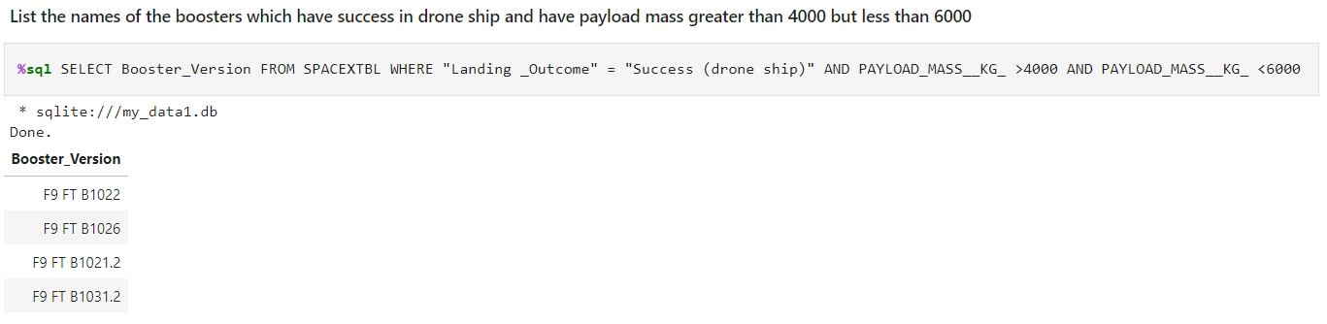
Successful Drone Ship Landing with Payload between 4000 and 6000
Using basic SQL, we listed the names of boosters which have successfully landed on drone ship and had payload mass greater than 4000 but less than 6000.

Slide 32
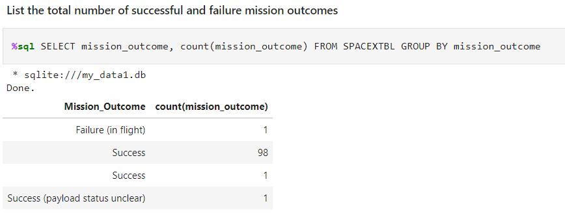
Total Number of Successful and Failure Mission Outcomes
We used SQL to calculate the total number of successful and failure mission outcomes

Slide 33
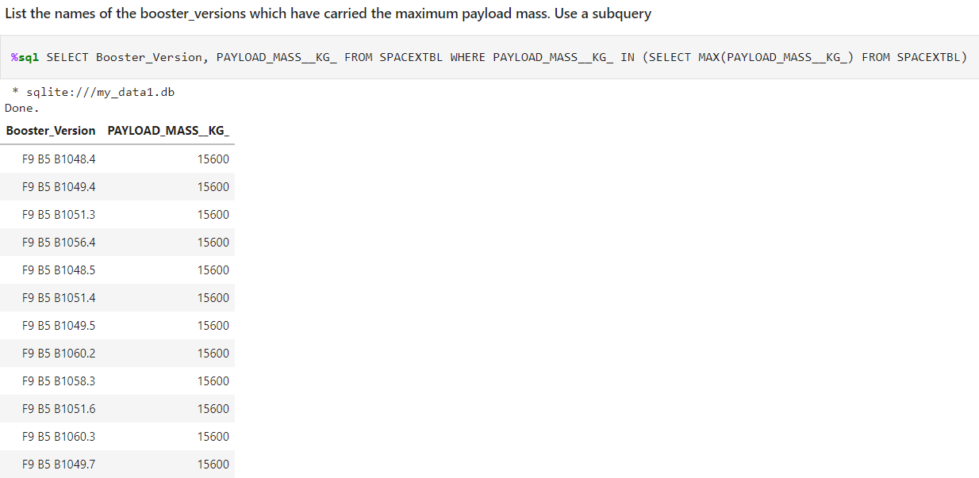
Boosters Carried Maximum Payload
Using SQL, we listed the names of the booster which have carried the maximum payload mass.

Slide 34
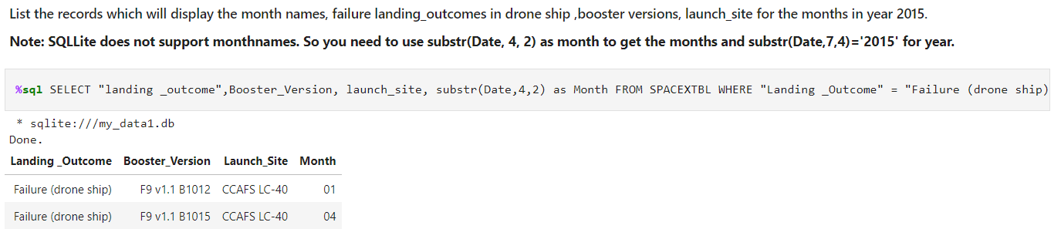
2015 Launch Records
List the failed landing_outcomes in drone ship, their booster versions, and launch site names for in year 2015
Present your query result with a short explanation here

Slide 35
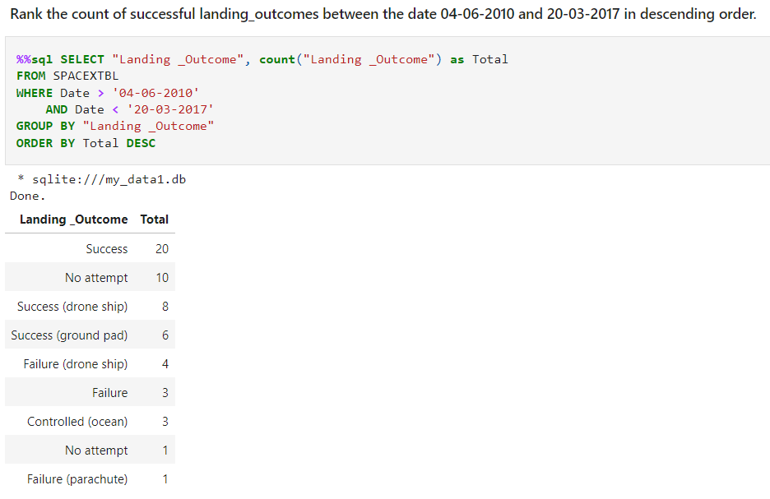
Rank Landing Outcomes Between 2010-06-04 and 2017-03-20
We used SQL to rank the count of landing outcomes (such as Failure (drone ship) or Success (ground pad)) between the date 2010-06-04 and 2017-03-20, in descending order

Slide 36

Section 3

Slide 37
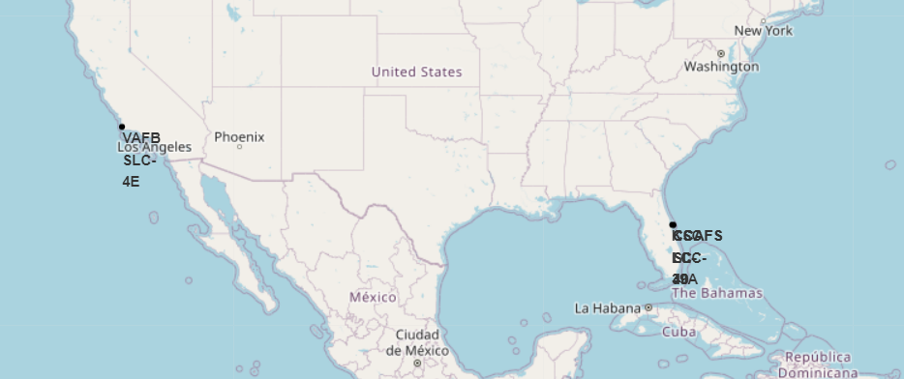
Launch Site Map
We can see from the map that all of the launch sites are located on the southern coast.

Slide 38
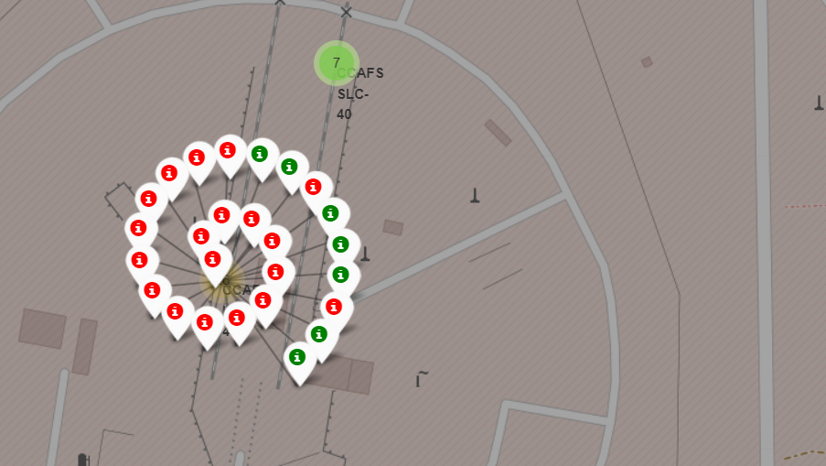
Map of Launch Outcome
We can see the Location and Launch Outcome of each F9 launch

Slide 39
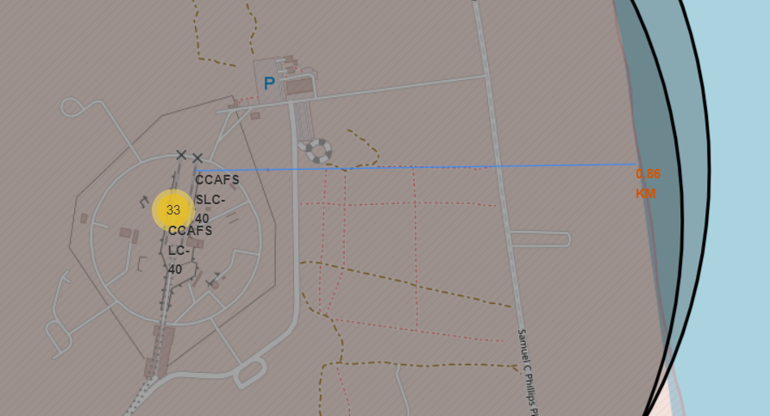
Map with Coastline Distance Calculation
Using this tool, we can calculate the distance to major geographical features such as coastlines, rail lines, roads, and cities from each Launch Site.

Slide 40

Section 4

Slide 41
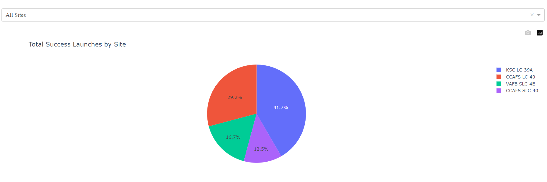
Success Rate by Site
The interactive dashboard gives us the ability to view success rate for each launch site compared to the total number of launches.

Slide 42
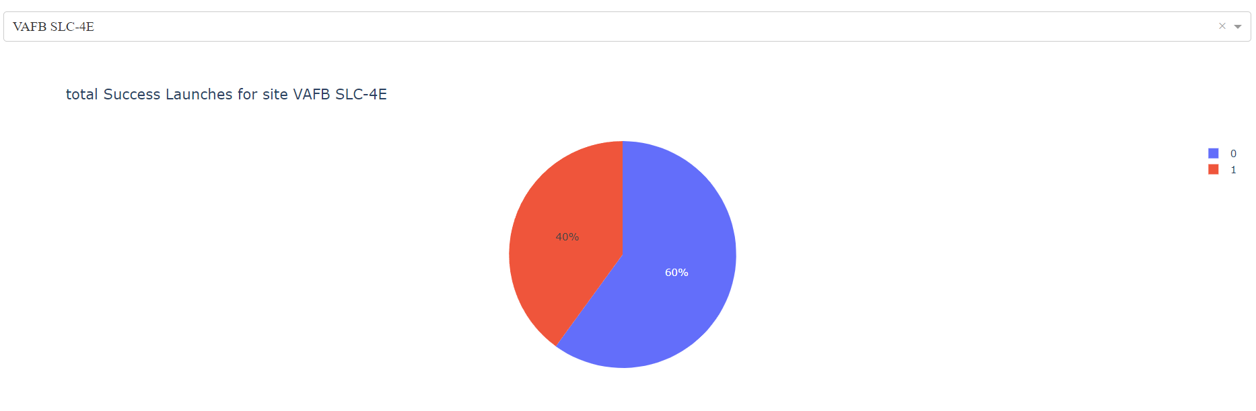
Total Success Launches by Site
We can also see the success rate for individual launch sites.

Slide 43
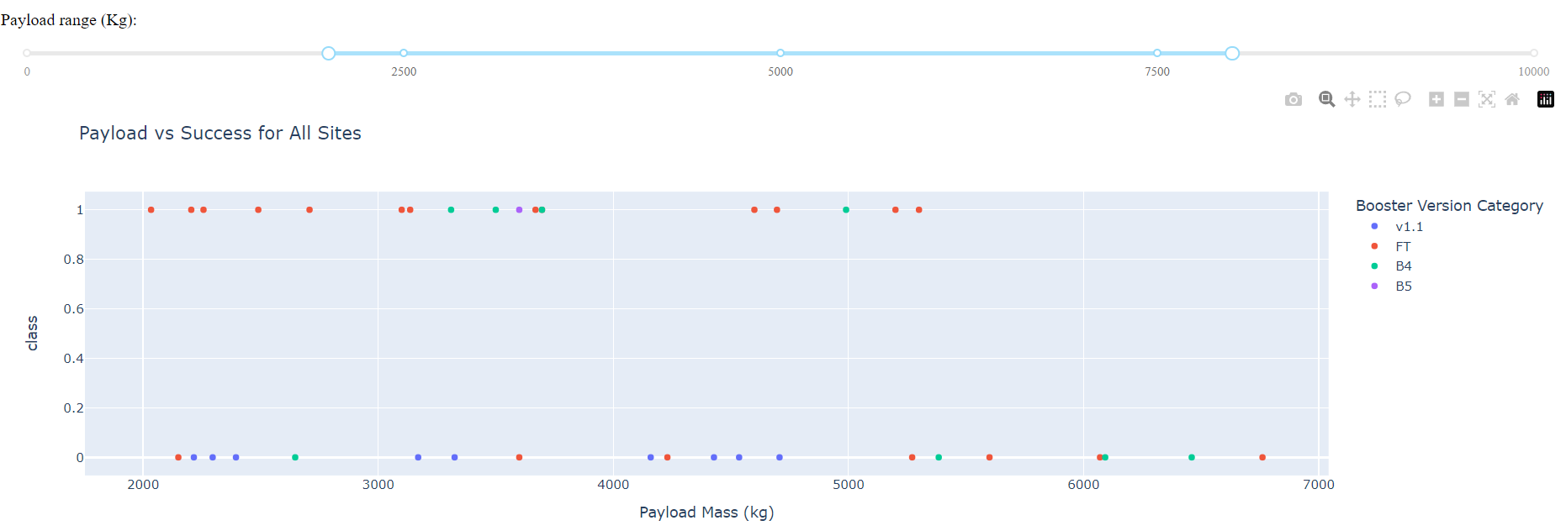
Success by Booster Version and Payload Mass
Lastly, we can view the Success Rate for each Booster Version while being able to select the range for Payload Mass.

Slide 44

Section 5

Slide 45
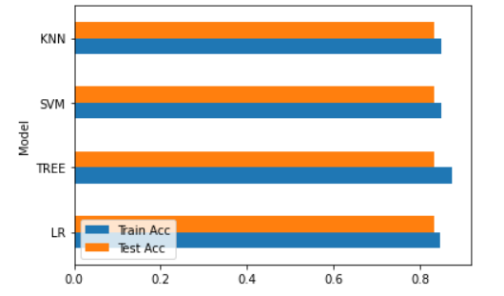
Classification Accuracy
All models achieved an 83% test accuracy, but the Decision Tree model achieved an 87.5% validation accuracy.

Slide 46
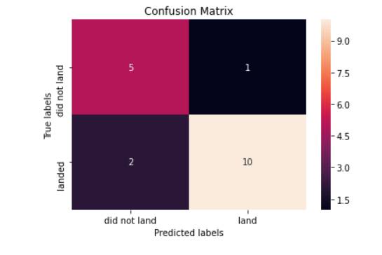
Confusion Matrix
We can see the Decision Tree model accurately predicted 15 of the 18 landing outcomes. With 2 false negatives, and 1 false positive.

Slide 47
Conclusions
Success Rate increases as Flight Number Increases
ES-L1, GEO, HEO, and SSO have best success rates.
KSC LC-39A has the highest success rate.
Launch Success increased from 2013-2019.
Decision Tree is the best prediction model.

Slide 48


